Slide 1
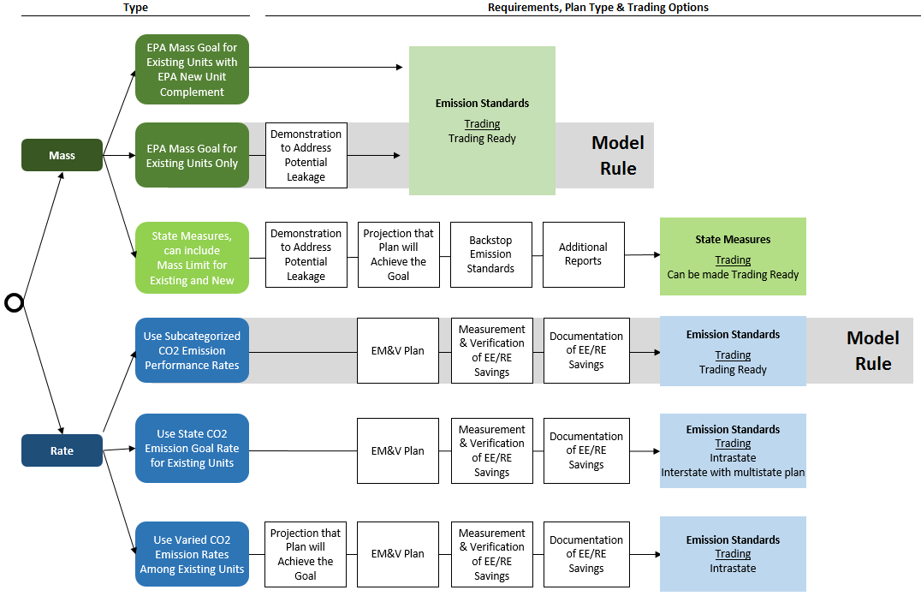
Regulatory Framework Options

Slide 2
State Measures without Emission Standards
Pros
Cons
Affected EGUs not subject to federally enforceable requirements unless backstop triggered
Is this a benefit for the state?
Projection of compliance with mass-based goals required
Still have to comply with mass-based goals
Have to make up shortfall if fail to comply
Unclear how to demonstrate no leakage if adopt existing EGU-only option
State measures have to meet EPA enforceability criteria at state level (60.5780)
No interstate trading (nothing to trade)

Slide 3
State Measures with Emission Standards
Pros
Cons
???
Projection of compliance with mass-based goals required
Still have to comply with mass-based goals
Have to make up shortfall if fail to comply
Unclear how to demonstrate no leakage if adopt existing EGU-only option
State measures have to meet EPA enforceability criteria at state level (60.5780)
Interstate trading requires “import”/”export” accounting

Slide 4
Rate-Based with Varied Rates
Pros
Cons
Rates can be tailored to distribute burdens of compliance more equitably
Will result in protracted debate about what rate structure is equitable (similar to allocation issue)
Projection of compliance with goal required
Interstate trading is not allowed

Slide 5
Rate-Based Using State-Wide Goal
Pros
Cons
Less stringent for NGCC
Is this a benefit for the state?
More stringent for coal-fired EGUs
Is this a detriment for the state?
Not trading ready; interstate trading requires multistate plan

Slide 6
Regulatory Framework Options – Low Priorities Shaded

