Slide 1
EPA’s Proposed Federal Clean Power Plan
Steve Burr
AQD, SIP Section
October 6, 2015

Slide 2
Overview
Mass-Based Components
CPP Requirements
Proposed Federal Plan Implementation
Rate-Based Components
CPP Requirements
Proposed Federal Plan Implementation
Federal Plan and Model Rule

Slide 3
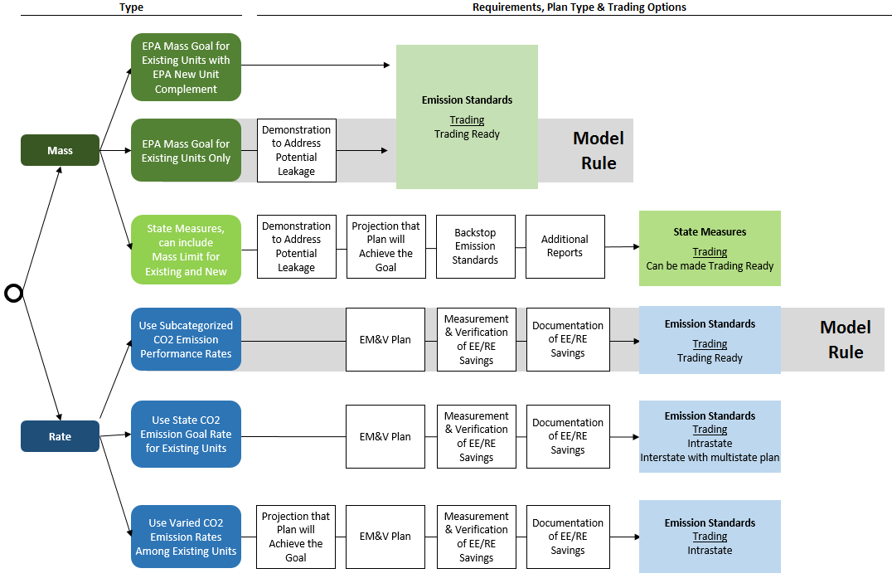
Overview

Slide 4
Mass-Based Plan Elements
Emissions Budget
Allocation of Allowances
Monitoring, Reporting, and Recordkeeping (MRR) Requirements
Tracking System
Process for Demonstrating Compliance
Requirements to Address Leakage
CEIP (optional)
EM&V for RE and EE (depending on plan type)

Slide 5
Mass-Based Plan: Budget
Federal Plan: Single-State Goal
EPA lacks authority to adopt “new source complement”
Arizona Mass-Based Goals (short tons CO₂)
Interim | Final
33,061,997 | 30,170,150

Slide 6
Mass-Based Plan: Allocation
How allowances work:
Allowances vs. ERCs

Slide 7
Mass-Based Plan: Allocation
CPP: Plan must include “provisions”
For allocation of allowances for each compliance period for each EGU (including set-asides)
For adjusting allocations
Allowing or restricting banking
Prohibiting “borrowing”
Federal Plan
Based on EGU’s share of 2010-2012 generation
3 set-asides: 2 to address leakage (below) + CEIP
Unlimited banking allowed
Notes:
60.5815

Slide 8
Mass-Based Plan: Allocation
Federal Plan (cont’d)
If EGU does not operate for 2 consecutive calendar years, would only receive allowances for “limited number of years”
Specific proposal: after 2 consecutive years without operation, no allowances in next compliance period; EPA seeks comments on alternatives
Implications for NGS, Four Corners, AZ EGUs
How are retirements before 2022 treated?
States may replace EPA determined allocation system with state-developed provisions
Notes:
60.5815

Slide 9
Mass-Based Plan: MRR
CPP
CEMS for hourly CO2 emissions (with some exceptions)
Sum hourly emissions for compliance period
Monitoring of net electricity output also required. (Why?)
Federal Plan
Same
Requires “Designated Representative” to certify all reports
Notes:
60.5815

Slide 10
Mass-Based Plan: Tracking System
CPP
Electronically record
Allocation of allowances
Transfers of allowances
Surrender and retirement of allowances for compliance
Provide internet-based, public access to information relating to “eligible resources”
May provide for transfers to or from an EPA-approved or –administered system
Federal Plan
Designated Representative = Authorized Account Representative
Notes:
60.5815

Slide 11
Mass-Based Plan: Demonstrating Compliance
CPP
Demonstrate compliance by holding in tracking system allowances ≥ emissions in short tons
Federal Plan
Allowances available for deduction for a compliance period
Allocated for year in compliance period or prior compliance period (no borrowing)
Held in EGU’s compliance account as of “allowance transfer deadline” (May 1 after end of compliance period)
EPA deducts allowances until
Amount deducted = total emissions from facility’s EGUs; or
No allowances remain (i.e. there are excess emissions)
If excess emissions, EPA will deduct 2X shortfall
Notes:
60.5815

Slide 12
Mass-Based Plan: Leakage
What is leakage?
“emissions from new sources, beyond the emissions expected from new sources if existing EGUs were given standards of performance in the form of the subcategory-specific emission performance rates” [60.5790(b)(5)]
Notes:
60.5815

Slide 13
Mass-Based Plan: Leakage
CPP Options
Regulate new EGUs under state-only program together with existing affected EGUs under a mass-based 111(d) plan (“new source complement”)
Allocation method that counteracts incentives to shift generation to new EGUs
Provide demonstration that leakage is unlikely to occur in a particular state
Notes:
60.5815

Slide 14
Mass-Based Plan: Leakage
Federal Plan Allocation Adjustments
Output-based allocation adjustments
Provides existing EGUs incentive to generate more to receive more allowances, aligning incentive with new sources
Proposed to be available only to NGCC
Eligible NGCC would receive allowances = net generation > 50 % of net summer capacity x allocation rate of 1,030 lb/MWh-net
Proposed AZ set-aside = 4,197,813
Allowance set-aside for post-2012 RE:
5 % from annual allowances (1,508,538 in 2030 for Arizona)
Only utility scale wind, solar, geothermal power or utility scale hydropower qualify
Unused set-aside allowances allocated to eligible generation on pro-rata basis
Notes:
60.5815

Slide 15
Mass-Based Plan: CEIP
CPP
Eligible Projects
Located in or benefit a state implementing CEIP
Commence construction (RE) or operation (EE) after submission of final plan
During 2020-2021, either (a) generate metered MWh from any wind or solar resource or (b) result in quantified and verified electricity savings through demand side EE in low-income communities
ERCs
RE Projects: For every 2 MWh generated, project receives 1 ERC from state and 1 matching ERC from EPA
EE Projects: For every 2 MWh generated, project receives 2 ERCs from state and 2 matching ERCs from EPA
Federal Plan
Includes CEIP
EPA takes state role of creating RE and EE set-asides

Slide 16
Mass-Based Plan: EM&V
CPP: Required in mass-based plan, if includes
Set-aside for RE to address leakage; or
CEIP
Federal Plan
Includes both RE set-aside to address leakage and CEIP for RE and EE
Therefore includes EM&V for EE
Why doesn’t federal plan allow ERCs for EE in Rate-Based rules?
Notes:
60.5815

Slide 17
Rate-Based Plan Elements
Rate-Based Emission Standards
Method for Calculating Adjusted Rate
Identification of Eligible Resources
Certification of Eligible Resources
Issuance of Emission Rate Credits
MRR (same as for mass-based)
Evaluation, Measurement & Verification
Tracking System (same as for mass-based)
Notes:
MRR: actually use net electricity output in calculation

Slide 18
Rate-Based Plan: Standards
Federal Plan Standards: Subcategory-Specific Performance Rates
National Performance Rates (lbs CO₂/MWh)
Subcategory | Interim | Final
Fossil Steam | 1,534 | 1,305
NGCC | 832 | 771

Slide 19
Rate-Based Plan: Calculation Method
CPP and Federal Plan:
$${CO}_{2} emission rate=\frac{\sum{M_{CO2}}}{\sum{{MWh}_{op}+\sum{{MWh}_{ERC}}}}$$
ERCs may come from
Affected EGUs with rate below performance standard and
“Eligible resources”

Slide 20
Rate-Based Plan: Eligible Resources
CPP
Installed or implemented after 1/1/2013
Connected to and delivers energy or saves electricity on grid
Located in:
Rate-based state
For RE only, in mass based state and delivered with intention to meet load in rate-based state
Categories
RE: wind, solar, geothermal, hydro, wave, tidal
Qualified biomass
Waste-to-energy
Nuclear
CHP
Demand-side EE
Other included in state plan and approved by EPA

Slide 21
Rate-Based Plan: Eligible Resources
Federal Plan Limited to
On-shore utility scale wind
Utility scale solar photovoltaics
Concentrated solar power
Geothermal power
Nuclear energy
Utility scale hydropower

Slide 22
Rate-Based Plan: Certification and Issuance
CPP and Federal Plan:
No ERCs
No
Eligibility Application
Eligible?
ERC DESK
Yes
Credit Application
No ERCs
No
Do Project
Verified?
ERCs

Slide 23
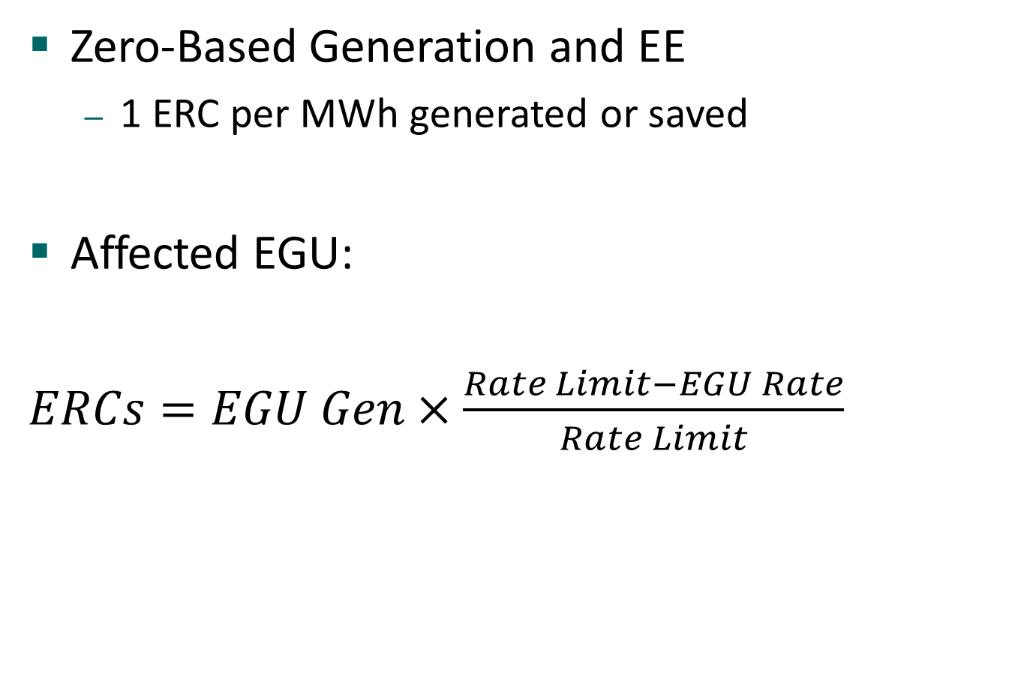
Rate-Based Plan: Certification and Issuance
Zero-Based Generation and EE
1 ERC per MWh generated or saved
Affected EGU:
$ERCs=EGU Gen×\frac{Rate Limit−EGU Rate}{Rate Limit}$

Slide 24
Rate-Based Plan: Certification and Issuance
NGCC in Performance Rate State
Problem:
Actual NGCC rate unlikely to be lower than performance rate, especially 771 lb/MWh in final compliance periods
Contrast state-wide rate in AZ: 1,031 lb/MWh
Performance rate provides no incentive for BB2
Solution
Award “Gas-Shift ERCs” (GS_ERCs)
$$GS_ERCs=EGU Gen ×Incr Gen Factor×(1−\frac{EGU Rate}{FFS Rate Limit})$$
Included in Federal Plan

Slide 25
Rate-Based Plan: EM&V
CPP
Eligibility Application
EM&V Plan
Verification report from independent verifier
Credit Application
M&V Report
Verification report from independent verifier
Federal Plan
30 pages of detail in both Mass-Based and Rate-Based rules
Accreditation process for independent verifiers

Slide 26
Overview

