Slide 1
State of the Arizona Energy System
Examining the current state of Arizona’s energy mix in the context of the Clean Power Plan

Slide 2
Who Am I?
Tai Wallace
Environmental Program Specialist
ADEQ | AQD | SIP | TAU
602.771.4455
wallace.tai@azdeq.gov

Slide 3
Introduction and Overview
Topics to be Covered
Arizona’s Energy Mix
Digging Deeper: Coal
Digging Deeper: Natural Gas
Digging Deeper: Renewables
Digging Deeper: Energy Efficiency
Conclusion
Notes:
My Name is Tai Wallace. I am an environmental Program Specialist in the State Implementation Planning Section of the Air Quality Division at The Arizona Department of Environmental Quality. I perform research and analysis on matters related to the comment and implementation of The Environmental Protection Agency’s Clean Power Plan Proposed Rule.
In this presentation I will be examining the current state of Arizona's Energy Mix. I will start with a high level overview and comparison of Arizona’s energy portfolio and how it compares to other states in the southwestern region. As the presentation progresses I will dig deeper into Arizona’s Coal, Natural Gas Combined Cycle, Renewable, and energy Efficiency assets, following the EPA’s Four Building Block methodology that Steve so graciously presented before me. Let’s Begin!

Slide 4
Arizona’s Energy Mix

Slide 5
Southwestern States Generation Portfolios
Coal
Natural Gas
Nuclear
Hydroelectric
Non-hydro Renewables
Notes:
Arizona has the most diversified Electricity Generation portfolio in the west. While the most prominent generation resource in the Arizona portfolio is Coal at 36% of our generation capacity, natural gas and nuclear generation make up nearly 30% of our generation portfolio and renewable generation accounts for about 7.5% of our generation and counting. These generation portfolios are all dependent on an interconnected infrastructure. Transmission infrastructure is needed to move electrons from load centers to demand centers. Gas infrastructure is needed to move gas supply from gas and shale plays to generating units and retail customers. Baseload and intermediate resources are necessary to firm renewable generation until the time that other technologies become commercialized and mature.
In fact, some of these firm resources in Arizona are used to supply baseload generation in other states. The trade index ratio captures this transport of electrons between states and even other countries. The net trade index ratio is the sum of total electricity supply (generation) within a state divided by the aggregate of the total disposition within that state and net interstate trade. A trade index ratio of less than one indicates a state is a net importer of electricity to supply retail load. Conversely a trade index ratio greater than one indicates a state is a net energy exporter. Arizona is a net energy exporter, and this is important when discussing who is responsible for emissions and avoided emissions. Is energy consumed in a net importing state as clean as the EPA calculations indicate if retail load is being served by coal and gas generation from out of state?
In essence, the transition to a cleaner energy economy is one that must be thoughtful and consider the implications of energy consumption, infrastructure and economic development within a state and to some extent beyond its borders.

Slide 6
Carbon Intensity of Arizona’s Affected Facilities
Coal Steam
Natural Gas Combined Cycle
Oil/Gas Steam
Notes:
Under the CPP, the EPA examined 19 facilities owned and operated by Electric utilities both in state and out of state or by merchant generators. These facilities are responsible for over 99% of the direct CO2 emissions from the electric power sector in the state.
The total mass of emissions from each of these sources is not equal. It is highly dependent on the utilization (capacity factor) of each f these facilities. He coal units tend to emit the most carbon emissions because they have the highest average annual carbon intensity of the affected conventional resources.
Although the Oil/Gas steam resources units have the next highest average carbon intensity, the emissions from these resources amount to less than 5% of direct carbon emissions from the sector as their utilization is reserved almost exclusively to meet peak demand and reserve requirements.
In fact, some of the larger NGCC plants like Mesquite, Gila River and Redhawk emitted more emissions in 2012 than the Apache Coal Generating Station simply for the fact their utilization was significantly higher.

Slide 7
Desert Southwest Transmission Infrastructure
Note: Image courtesy of Southwest Area Transmission Sub-Regional Planning Group
Notes:
The nation’s transmission grid is inherently interconnected. Over time, load centers have changed and generating capacity has grown to meet fluctuations and increases in demand. For this very reason, transmission infrastructure is planned and managed on a regional scale, allowing energy to cross state borders on both its wholesale and retail load serving capabilities to meet demand in a reliable fashion. Electricity is a commodity that is almost treated as a common good. When a customer flips a switch, there is a subconscious expectation that the power will be there, the frequency will be stable, and everything connected to the grid will simply work. One cannot understand the state of Arizona’s energy without looking beyond megawatt hours generated. To understand the electric power industry, one must view the system holistically.
Baseload generating resources consume a fuel and produce a waste stream. These resources must be sited outside of large population centers and their waste streams controlled to ensure they meet energy demand sustainably. Transmission infrastructure has been built to facilitate the grid in its current state. As we transition to a cleaner, more modern grid, more emphasis will need to be placed on building out a transmission infrastructure that accommodates resources such as renewables that have different citing considerations than conventional generation. Creating the grid of the future will be a heavy undertaking that requires large capital expenditures and thoughtful planning.

Slide 8
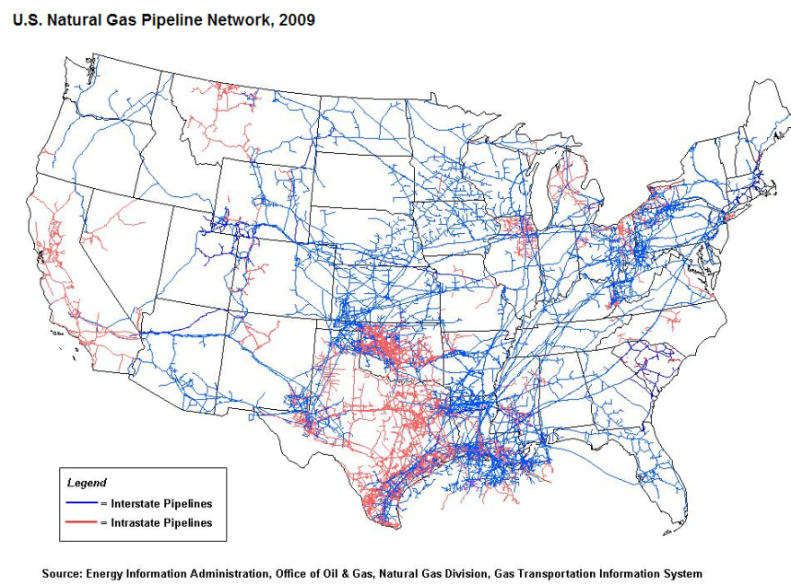
Arizona Natural Gas Infrastructure
Notes:
The same goes for our natural gas infrastructure. In the areas of the state where coal plants exist, there is often a lack of natural gas infrastructure. Fuel switching at some of these plants will require new natural gas infrastructure to be built. To maintain resiliency in the system, gas storage and infrastructure security are important aspects of planning future gas generation resources. In a future state where Arizona is reliant on natural gas for a significantly larger portion of its generation portfolio, reliability must be maintained so that an unplanned event that compromises one of the states major natural gas pipelines does not result in a large portion of our grid going down. In the hottest months, this scenario could prove to be a significant human health risk to the residents of Arizona.

Slide 9
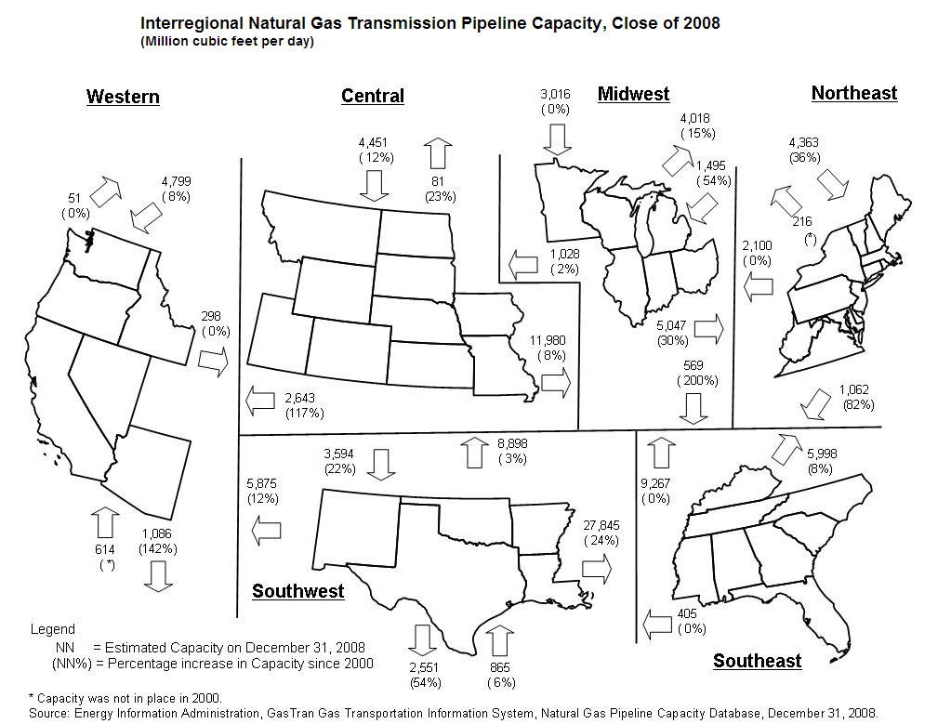
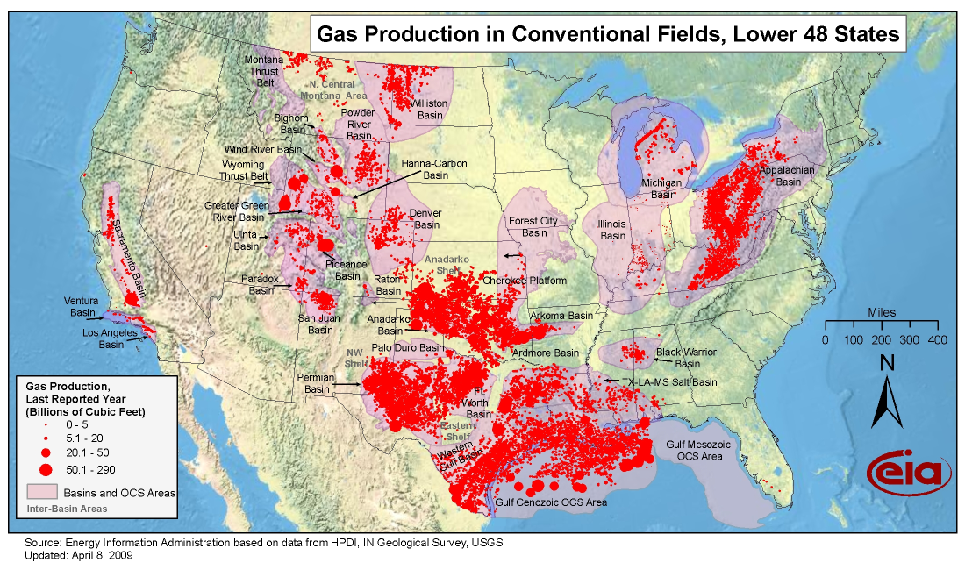
Regional Gas Capacity and Production
Net: 17,196
Net: -3,623
Net: 12,030
Net: 12,496
Net: -40,305
Net: 13,806
Notes:
In designing this new infrastructure, states must consider both gas pipeline capacity and production to ensure system reliability. Not that a transition from coal to gas cannot be achieved, rather it must be done right with the proper attention paid to regional grid stability. As shown in the first slide, Nevada and California already rely on natural gas for the majority of their electricity generation. As the states in the west increase their natural gas consumption, the region will become a much larger net importer of natural gas. Price volatility will become a much bigger risk to resource planning as gas supplies can be fickle as gas is difficult to store in reserve. Gas will have to be transported from the regions where there is a glut of production to the regions where demand is increasing. Additionally, other factors that impact gas production, such as availability of water ad regulation will need to be considered. The expected result of the implementation of the CPP will be a significant expansion of existing gas infrastructure to meet the increase in demand.

Slide 10
What is Integrated Resource Planning?
1
Assess System Needs
2
Consider Resource Options Available to meet System Needs
3
Select Portfolio that Offers Greatest Reliability and Lowest System Cost
5
4
Risk Assessment of Business Environment, System Needs and Resource Options
Develop Portfolio Options and Perform Multiple Scenario Analyses of Options
Integrated Resource Planning is the process of evaluating a full suite of resource options to provide reliable electric service to a utility’s customers at the lowest system cost over a defined planning horizon.
Notes:
So how do utilities plan for future resource needs and constraints? One tool is the Integrated Resource Planning Process. Integrated resource planning is the process of evaluating a full suite of resource options to provide reliable electric service to a utility’s customers at the lowest system cost over a defined planning horizon. The process involves the five steps outlined to the left.
Assess System Needs
Consider Resource options available to meet those needs
Assess risks such as infrastructure, changing business environment, increasing regulation, etc.
Develop a suite of portfolio options that address different scenarios
Select a portfolio option that offers the greatest reliability at the lowest cost to the rate payer.
That being said, IRPs rely heavily on forecasting and scenario planning. The products developed by utilities are only projections of resource needs and operating constraints identified at the time the IRP is completed.

Slide 11
IRP: Arizona Peak Load Requirement
What is Peak Load /Peak Demand?
What is Arizona’s Peak Load Requirement?
Maximum power requirement of a system during period of peak demand
Based on historic demand
Includes reserve requirements to meet peak demand during emergency situations
Notes:
What is peak load/peak demand? Peak load or peak demand is the maximum power required by a system during its expected period of highest energy demand. The two terms are generally interchangeable and are used to describe the required resource capacity to meet the single highest peak hour of demand. In the context of the IRPs, peak demand or peak load requirements are based on historic demand data and include required reserves to meet this demand in the event of a system failure or emergency.
Under the most recent IRPs submitted by AEPCO, APS, SRP, TEP and Unisource to the Arizona Corporation Commission or the Western Electricity Coordinating Council, Arizona Utilities have a current peak load requirement of over 19,500MW of generating capacity. This includes required reserve margins for all utilities, but does not include the avoided generation allocated to energy efficiency, distributed generation and demand response. To meet this load requirement, Arizona’s largest utilities currently have nearly 21,000 MW of generating resources. These resources include conventional thermoelectric generation, renewable generation, long-term wholesale PPAs and short-term PPAs to meet reserve margins. This overcapacity is not a bad thing as it is held by the utilities that serve the major urban population centers, which are expected to grow at a fast rate through the goal period.

Slide 12
IRP: Summary of Planned Capacity Changes
7738MW Low Carbon Intensity Resource Capacity Additions
345MW High Carbon Intensity Resource Capacity Reductions
Notes:
Nearly all utilities are planning capacity additions and reductions that will have a net effect of reducing the overall carbon intensity of their generation portfolios, some significantly. Based on the most recent publicly available IRPs from the state’s largest utilities, 345MW of high carbon intensity generation is planned to be converted to low carbon intensity resources by 2030. In addition, the Utilities intend to add thousands of MWs of low or no carbon resources to meet future demand. Here are some of the highlights from utility resource planning:
-APS plans to meet 52% of future growth with emission free resources, resulting in a reduction of their portfolio carbon intensity by 14% by 2029 under their base case plan.
-SRP hopes to add over 1000MW of natural gas and renewables resources in the next decade, driving down system wide carbon intensity and improving resource diversity.
-TEP would like to to cut its dependence on coal generation by 32% by 2028, reducing or retiring nearly 500 MW of coal generating capacity in Arizona and neighboring states.
-UNS wants to increase its own NG generation with modern combined cycle gas, thus reducing its reliance on PPAs that can include less efficient coal and gas generation.
All in all, Arizona’s utilities are planning on making meaningful reductions in their portfolio carbon intensity. While the CPP will likely drive utilities toward adjusting their plans and resource allocation timelines, the CPP does not represent a paradigmatic shift in the trajectory of the electric power industry as a whole in Arizona. It should be noted however, that although the reductions would occur under section 111(d) of the CPP, all of these new additions with the exception of renewable and energy efficiency additions would occur under the CAA section 111(b) program and would not be available fr section 111(d) compliance.

Slide 13
Digging Deeper: Coal Generation in Arizona

Slide 14
2012 Affected Coal Facilities and Ownership
CO₂
_{1.86 MT}
CO₂
_{8.47 MT}
CO₂
_{6.90 MT}
CO₂
_{10.38 MT}
Notes:
Arizona has four coal facilities affected by the Clean Power Plan Proposed Rule, not including tribal resources. These units are the Apache Generating Station, the Cholla Generating Station, Coronado Generating Station, and Springerville Generating Station. Under the CPP, states can improve heat rate up to 6% to reduce the carbon intensity of such plants, thus reducing the emission rate of the state’s portfolio.
In 2012, Arizona power plants emitted approximately 40 Million Tons of CO₂ into the atmosphere. These four generating stations were responsible for nearly 70% of these emissions.
That being said, it is not as simple as shutting down these facilities to reduce carbon emissions. These facilities provide firm power to Arizona and other states that is critical to powering the Arizona Economy and maintaining electricity reliability for Arizona Residents during the hottest months

Slide 15
How Does Arizona Compare?
Notes:
Arizona’s coal fleet is the sixth youngest in the nation. In general, the coal fleets in the western United States are younger than the fleets in Eastern states.
Arizona’s average coal unit has a rated capacity of about 330 MW, about ten percent less under actual operating conditions. This is about the median for all states with coal units as well as amongst the six other states in the region. All units combined, Arizona’s coal fleet has a rated capacity of about 3900 MW under normal operating conditions.
In the last few decades, Arizona’s rate payers have made a significant investment into building Arizona’s coal fleet, and the fleet is already one of the more efficient coal fleets in the country. Arizona’s atypically young coal fleet generally performs as well as or better than older units of comparable size and utilization in other states. As a younger fleet incorporates technologies and best practices not available to some older facilities, Arizona utilities typically do not think it feasible to improve coal unit heat rates by the 6 or 4 percent available under BB1 or the alternate goal. Improvements of 1.5-2% are more realistic considering a number of the improvements available have already been implemented at Arizona coal units. Abandoning all of these coal units before they have been able to operate through their remaining useful life will result in stranded investment costs that will be passed directly to the rate payers.

Slide 16
2012 Affected Coal Unit Heat Rate
Notes:
Heat rate is a measure of the fuel input divided by the net generation…In this case, the effective heat rate is a measure of how effectively the heat inputs (thermal capacity of the fuel) is converted into load serving generation. The lower the heat rate, the more efficient the use of fuel in producing electricity. As can be seen, the older or smaller coal facilities (Apache Station or Coronado) are generally less efficient than newer or larger generating stations such as Springerville and Cholla. Both operational and technological factors impact heat rate and thermal efficiency of generating units, so heat rates can fluctuate based on pollution controls installed, operating conditions, and operating capacity. In general though, the newest plant, Springerville, performs better than any of the other plants in Arizona’s Coal fleet.

Slide 17
Digging Deeper: Combined Cycle Natural Gas Utilization in Arizona and the Region

Slide 18
Regional Annual Capacity Utilization
Notes:
The EPA calculated the average capacity factor for states using nameplate capacity. ADEQ recalculated these averages for Arizona and the other states in the region using nominal unit capacities. This is a more realistic method as nameplate capacity is based on manufacturer ratings at Standard temperature and pressure. They do not reflect real world capacity ratings which are typically ten percent less than nameplate. Additionally, operation is based on the factors that are used to calculate nominal capacity, so capacity factor calculations must be made using nominal capacity to compare apple to apples.
Considering all of this, it appears that Arizona has the lowest capacity utilization at its NGCC units compared to other states in the region. This annual utilization is a large factor behind EPA making Arizona’s reliance on Building Block 2 so large in the goal computation equation. Although it appears that Arizona does not utilize its NGCC capacity and has significant flexibility to increase NGCC utilization to meet its 2030 goal, a closer examination reveals an Arizona compliance strategy is not so simple.

Slide 19
Notes:
When you look at this annual average, and break the capacity utilization down to a monthly temporal profile, you can see that our utilization profile is unique in the region. Arizona has a huge temperature swing, particularly in Phoenix, one of the nation’s most populous metropolitan areas. This creates an annual energy profile that peaks significantly during the long summer months. The NGCC capacity in this state was designed to be an intermediate capacity resource with fast acting capabilities to meet peak summer demand. As you can see, Arizona has the greatest change in capacity utilization of any state on a month to month basis. When you examine the data on a peak hour basis, this delta is even more profound, reaching nearly 100% utilization.
If the state were to redispatch coal generation with existing NGCC capacity, the state would either need to supplement the peak demand periods with more carbon intensive oil/gas steam units and coal generation in the summer months, or build out significant additional NGCC and renewable resources under the 111(b) program. The first option is unfeasible as it would result in the greater utilization of less efficient generation resources to meet peak and intermediate demand and coal units to be run at a high O&M cost outside of their original economic and engineering design. While the state can build more NGCC and renewable resources, the planning horizon would likely result in the interim goal being missed because it would be difficult to build out the gas and transmission infrastructure by 2020.

Slide 20
Arizona NGCC Utilization and Ownership
Although EPA included an older generating unit at the Apache Generation Station in the 2012 baseline goal computation methodology, the EIA and Department of Energy no longer consider the unit a combined cycle unit for reporting purposes.
Notes:
There are also other challenges that Arizona faces in ramping up NGCC utilization so quickly. Half of the NGCC units in the sate are merchant generators. These units sell their power on the wholesale market or have long-term contracts with entities that are out of state. Basically, not all of the capacity in state is available to meet in state load requirements. Additionally, Arizona utilities are not confined by state boundaries. They have conventional generation resources in other states that they may need to ramp or shed because of the CPP. These resources are outside of Arizona’s jurisdiction just as the resources in Arizona serving load in other states are out of those states jurisdiction.

Slide 21
Digging Deeper: Renewable Energy in Arizona and the Region

Slide 22
The Renewable Energy Standard and Tariff (REST)
The Arizona REST requires certain electricity providers to meet 15% of their annual retail load with renewable energy by 2025—30% of which must be met by distributed generation resources
Includes sources not considered in goal computation
Allows for multipliers on renewables installed prior to 2005
Does not apply to all utilities
Includes some resources that avoid generation
Notes:
-Includes Hydroelectric and CHP/Cogen
-RECs generated from renewables installed prior to 12/31/2005 can have multipliers that allow for credit at 200% of generation
-SRP is exempt, although it has a sustainable energy goal that is non-binding by the state
-Some resources, such as solar hot water heaters, and solar space heaters are often viewed as energy efficiency resources rather than renewable energy generation resources.

Slide 23
Regional RPS Compliance in a “Business as Usual” Case
Challenges of using RE for Compliance
Interstate trade
Distributed Generation Resources
Uncovered sources
REST multipliers
Definition of what is renewable
Avoided rate changes over time
Note: from WECC 2013 Interconnection-Wide Transmission Plan Summary
(http://www.wecc.biz/committees/BOD/TEPPC/External/2013Plan_PlanSummary.pdf)
Notes:
Under the goal computation methodology, the EPA calculates state goals using the total generation from renewable resources in each state. However, for compliance, EPA proposes allowing the use of a state’s renewable portfolio standard, or in the case of Arizona, The REST as a compliance mechanism. This resents a number of challenges a state must overcome.
The first is interstate trade. According to the 2013 WECC interconnection wide transmission plan, The affected utilities in most states in the west do not plan to fulfill their REST/RPS requirements or goals using solely in-state generation. For example, California and Arizona will fulfill their requirements using between 10 to 25 percent out of state resources. Utah will meet its voluntary goal using almost exclusively out-of-state renewable generation resources.
Additionally, some states like Arizona and Colorado have specific requirements to supplant retail sales with distributed generation. While these resources were not included in the goal computation for each state, the resources can be used for compliance. The challenge will be designing a compliance program that captures these activities and any grid defectors in a state plan that covers all electricity providers and not just the regulated utilities.
Additionally, States will have to address the myriad of RPS and REST compliance requirements among the regulated and unregulated utilities and energy providers; the issue of Rest or RPS credit multipliers that would result in the double counting of avoided emissions; the variation between the State’s and the EPA’s definition of renewables; and lastly the actual avoided emissions from installing new generation resources as the state’s emission rate declines over time.
All of these factors point to the need for some sort of inter agency and multi state cooperation. This need not necessarily be a multistate plan, but states will have to agree on how to account for the mismatch between in state renewable generation and renewable generation for REST or RPS compliance used to serve retail load.
All in all, the CPP’s goal computation is not perfectly aligned with Arizona’s REST, but it does allow for greater compliance from Renewables than the REST. States are afforded the flexibility to include renewable resources other than utility scale resources used in the goal computation. The challenge will not be in meeting the renewable portion of the goal, rather it will be in building the institutional capacity to enforce, monitor and verify the environmental benefit of of both utility and distributed renewable generation included in state plans.

Slide 24
Digging Deeper: Arizona Energy Efficiency

Slide 25
The Arizona Energy Efficiency Resource Standard (EERS)
Investor Owned Utility Standard
Natural Gas Utility Standard
The Arizona EERS requires IOUs to achieve cumulative energy efficiency savings equal to 22% of the previous year’s retail electric sales by 2020.
The Arizona EERS requires every natural gas utility to achieve cumulative energy efficiency savings equal to 6% of the previous year’s retail gas sales by 2020.
Rural electric coops are required to meet 75% of the standard
SPR is not covered by the ACC standard, but has a Sustainable Portfolio Objective that requires specific levels of energy efficiency
Up to 2% of the retail savings can come from peak demand savings in the target year
EE Savings from Certain RE projects can account for up to 25% of standard in any year
Gas Coops and propane companies must meet 75% and 50% of the standard respectively
Notes:
The EERS applies to Investor owned, Cooperative, and rural electric coops, as well as Gas utilities, gas coops and propane companies. The affected electric utilities are expected to achieve cumulative efficiency savings of up to 22% by 2020, while the affected gas utilities are expected to achieve 6% cumulative savings over the same period. It should be noted that while peak demand savings can only account for 2% of the goal for Investor Owned Utilities, there is not necessarily a limit to the peak demand savings that can be counted under the CPP.
SRP is a public utility so their utility board approves funding for demand side management programs, similar to the ACC. SRP also has a large portfolio of well-established energy efficiency programs and a similar goal through their Sustainable Portfolio Principles (SPP) Objective. The SPP Objective is a Board mandate which requires SRP to have 20% of its resources come from sustainable resources by the year 2020. Within the goal, there is an EE component and annual EE savings targets which grow from 1.50% in 2012-2014 to 2.00% in 2018-2020.
An area that may pose a challenge is that affected utilities are allowed to account for up 25% of any one year’s goal by using energy savings from sponsored renewable energy projects. The effect this has on double counting is unclear at this point until ADEQ can look over the compliance data from the EERS.

Slide 26
How does Arizona Fare in Terms of Energy Efficiency?
Arizona Energy Efficiency
Government
Appliance Standards
Buildings
Transportation
Utilities
Notes:
Arizona is a leader in energy efficiency. The American Council for and Energy Efficient Economy has ranked Arizona 12th amongst the all states in their most recent energy efficiency score card based on energy efficiency policies and programs. Arizona is a leader in energy efficiency.
Arizona utilities have a growing portfolio of energy efficiency programs that result in avoided or reduced emissions that displace fossil fired generation. Even utilities not governed by the ACC have implemented demand side management programs, helping make Arizona a leader in efficiency. In addition, the ACC has granted full and partial revenue decoupling to change the business model for these utilities to allow cost recovery for declines in retail sales due to things like efficiency. This removes the incentive for regulated utilities to increase sales to increase revenue generation.
Besides the EERS Arizona state government also promotes energy efficiency by example through its government buildings and contracts standards. The state funds energy efficiency research and development through its three state universities. The state also offers limited consumer incentives such as property tax exemptions.
The state has appliance standards that set minimum efficiency requirements for certain appliances sold in the state, and many state localities have adopted building codes that promote energy efficiency. The local jurisdictions that have adopted modern building codes covers 90% of the state’s population.
Even the states ta incentives for alternative fuel vehicles can have an impact on energy efficiency in Arizona. As more plug-in electric vehicles are registered in the state, energy consumption patterns will change, creating more opportunities for efficiency in the future.

Slide 27
Energy Efficiency Measures
Demand Response
Incentives and Rebates
Codes and Standards
Energy Management
Reduced Demand
Energy Storage
Educational programs
Notes:
There are a number of energy efficiency measures states can employ to claim credit towards meeting state goals.
Demand response strategies can be very effective in reducing load during critical periods. These strategies can include non-disruptable programs such as time of use pricing or peak time rebates that give a financial incentive to minimize peak usage, all the way up to direct load control or interruptible load programs that allow system operators to remotely control or interrupt load during critical peak times. Energy storage systems are also demand response technologies in where they allow for utilities and consumers to store cheaper power for higher demand periods, increase the value of renewables, or smooth intermittent resources; all displacing the need for operating fossil peaking units to meet the avoided load.
States can also employ energy efficiency programs—programs that actually promote the consumption of less electricity without reducing the amount of work performed. Strategies such as offering rebates for installing more energy efficient appliances or equipment; more stringent building codes or energy standards; employing energy management technologies; or designing educational programs to increase energy efficiency will all add to reduced demand on the system.
All of these strategies should be creditable under the program, many of which are already being employed in Arizona. The challenge will not be getting Arizonans to be more energy efficient, rather it will be creating the evaluation, measurement and verification programs that conform with Clean Air Act requirements to capture these energy savings. The three largest electric utilities in the state, APS, SRP and TEP currently following industry best practices and use the services of the third-party measurement and evaluation firms that are capable of creating a process for the State.

Slide 28
Conclusion
A steep interim goal will create large infrastructure needs
Reliability is a key consideration
Arizona utilities are already planning to reduce carbon intensive resources and increase low/no carbon resources
Coal generation will decline, but Arizona does have the nation’s 6th youngest coal fleet
Natural gas generation will increase
Renewables and energy efficiency are a vital part of Arizona’s energy portfolio
The CPP is intended to be achievable without being a burden to the state

Slide 29
References
SRP. (December 19, 2012). Integrated Resource Plan FY2013. Joint Filing to the Western Area Power Administration (WAPA). SRP. Town of Gilbert. Fort McDowell Yavapai Nation. Salt River Pima-Maricopa Indian Community
Arizona Corporation Commission (December 11, 2012). Assessment of the 2012 Integrated Resource Plans of the Arizona Electric Utilities. ACC Docket no. E-00000A-11-0113
Tucson Electric Power. (April 1, 2014). 2014 Integrated Resource Plan.
Unisource Energy. (April 1, 2014). 2014 Integrated Resource Plan.
Arizona Public Service. (April, 2014). 2014 Integrated Resource Plan.
EPA. (June 2, 2014). Clean Power Plan Proposed Rule TSD: Appendix 7 Plant Level Data used for Goal Computation. [Excel].
http://www.azgt.coop/electricity-generation-and-transmission/generation/arizona-electric-power-cooperative/
https://www.srpnet.com/
https://www.aps.com/en/residential/Pages/home.aspx
http://www.eia.gov/
http://www2.epa.gov/carbon-pollution-standards/clean-power-plan-proposed-rule-technical-documents
http://ghgdata.epa.gov/ghgp/main.do
http://www.dsireusa.org/
http://www.azcc.gov/
http://www.aceee.org/sector/state-policy/arizona

