Slide 1
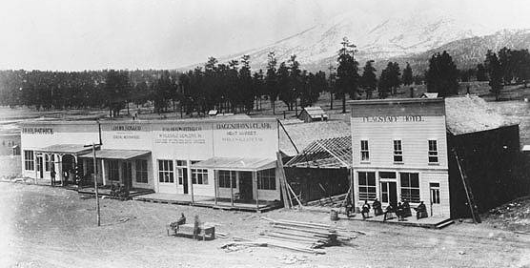
City of Flagstaff City Manager’s Compounds of Emerging Concern Advisory Panel
by
Bradley M. Hill, R.G.
Utilities Director
Arizona Department of Environmental Quality
Advisory Panel on Emerging Contaminants
September 27, 2013
Early Flagstaff

Slide 2
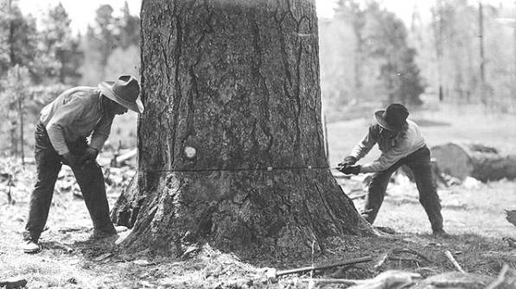
HISTORY
1973 - City started directly delivering reclaimed water to
Continental Country Club Golf Course
1993, City expanded its direct delivery of reclaimed water with the construction of its 2nd wastewater treatment plant [city parks, school district, 2nd golf course, industry, etc]
2002, City signed an Agreement with the Arizona Snowbowl to directly deliver 552 AF/year of reclaimed water for snowmaking
2012, In August a report was released by Virginia Tech University found Antibiotic Resistance Genes in the City’s reclaimed system and in December the Arizona Snowbowl started snowmaking

Slide 3
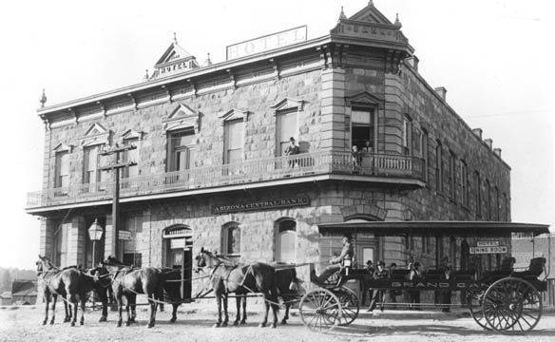
WHY an Advisory Panel Now?
2012, the topic of reclaimed water use became amplified in the community
City Council became bombarded with citizens questions regarding the safety of using reclaimed water for irrigation, recharge or snowmaking
September 2012, City Manager requested staff to develop a panel of experts to assist in the evaluation of the human health impacts from the local use of reclaimed water
1st Meeting – January 25, 2013
McMillan Bank & Hotel- 1900

Slide 4
Membership
David Engelthaler, Director TGEN North (epidemiologist)
Robert Hart, Scientist in Charge, U.S. Geological Survey
Jean McLain, Ph.D., University of Arizona
Rod Parnell, Ph.D., Northern Arizona University
Randy Phillips, Coconino County Health Services
Amy Pruden, Ph.D. Virginia Tech University
Forrest Ritland, M.D., Flagstaff Medical Center (pathologist)
Robin Silver, M.D.
Tom Whitmer, Director Natural Resources, City of Cottonwood
Cathy Proper, Ph.D. Northern Arizona University *
Channah Rock, Ph.D., University of Arizona *
Shane Snyder, Ph.D., University of Arizona *
* ADEQ - APEC members

Slide 5
PURPOSE & OBJECTIVES
What does the detection of Compounds of Emerging Concern (CECs) in some parts of the City of Flagstaff’s Drinking and Reclaim Water Distribution Systems mean for possible human health effects beyond what already exists?
Determine what specifically to study
Identify what steps are necessary for understanding the human health effects of CECs in raw, drinking and reclaimed water
Provide guidance to the City on developing a work plan on how best to achieve this knowledge.
Panel met 3 times in 2013

Slide 6
CEC Sampling in Flagstaff
2002 evaluation of existing data from Rio WRF v. SDWA
2002-2006 Hired USGS & NAU to sample both drinking & reclaimed water for pharmaceuticals & other industrial compounds at Wildcat Hill WWTP, Rio WRF & 3 groundwater wells. NAU analyzed effects of reclaimed water on Mosquitofish, bullfrogs & African clawed frogs;
2010 City sampled drinking & reclaimed water for 87 PPCPs & EDCs
A. drinking water distribution system: caffeine 82 ng/L, DEET 2.1 ng/L, Theobromine 66 ng/L, Triclosan 19 ng/L & lohexal 42 ng/L
B. Reclaimed system 33 were detected

Slide 7
Previous CEC Sampling Summary
2011 Lake Mary raw water & treated water tested for 90 PPCPs & EDCs
Raw intake water: BPA 22ng/L, naproxen 10ng/L, theobromine 23ng/L)
Treated, pre-chlorination: DACT 7.6 ng/L, naproxen 12ng/L & theobromine 43 ng/L
2012 Sampled reclaimed water & compared to compliance with SDWA
260 analytes were tested as required for drinking water, 10 were detected, but under MCL
Aldicarb sulfone, arsenic, barium, chromium, diquat, flouride
Nitrate, sodium, sulfate, gross alpha

Slide 8
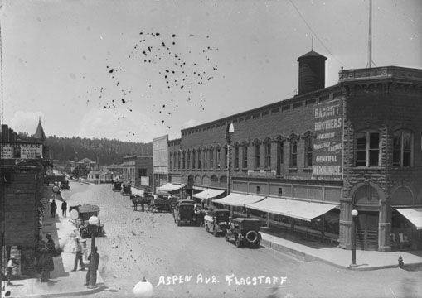
INTERIM REPORT
July 16, 2013
Framework: CECs into 3 categories – pharmaceuticals, endocrine disrupters
and antibiotic resistance genes and associated bacteria
Prioritize most critical to issues addressing the concerns raised by the use of
reclaimed water by the City: human health impacts as opposed
to animal, aquatic or environmental impacts
Babbitt Brothers downtown
Flagstaff

Slide 9
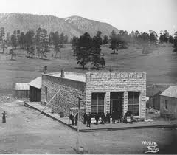
INTERIM REPORT
July 16, 2013
Findings/Advice – Drinking water: USEPA’s Contaminant Candidate Lists (CCL)
may warrant future regulation. Antibiotic Resistance Genes are not on
The CCL3 list, but 9 hormones & 1 antibiotic is on list. No documented
study exists from around the world on human health impacts of the 10
.
Monitoring of any CECs on the CCL3, beyond
unregulated contaminant monitoring rule
(UCMR) in Flagstaff’s drinking water
at this time is unnecessary

Slide 10
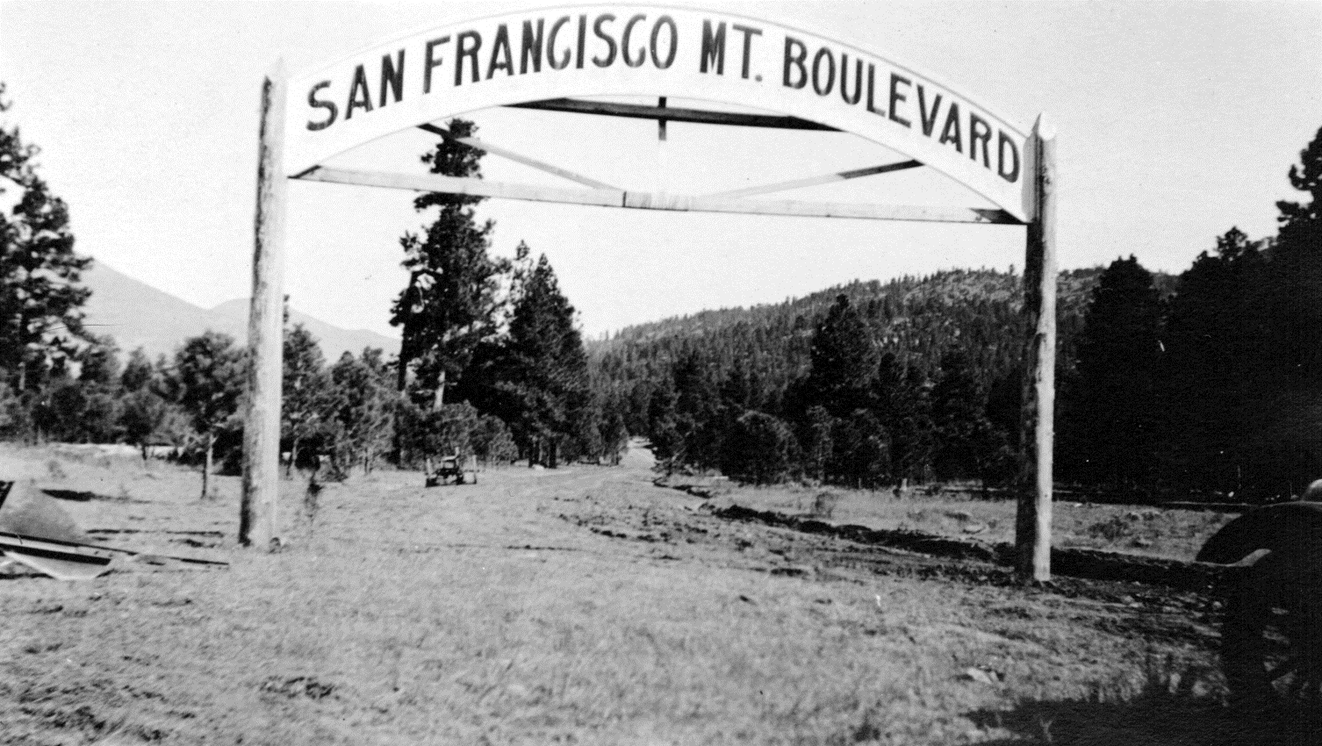
INTERIM REPORT
July 16, 2013
Findings/Advice – Reclaimed water: 3 CCL3 chemicals have been detected in
reclaimed water that deserve noting – 17 beta estradial, triclosan,
and NDMA. Caffeine & triclosan were detected in Flagstaff’s
reclaimed water, but are removed when treated with chlorine.
Monitoring of caffeine and 17-beta estradiol in reclaimed water was
appropriate, but treatment beyond adding free chlorine is not
warranted at this time.
1921, now Schultz Pass Road.
Photo Credit: Arizona Historical Society, Flagstaff [AHS.0467.00075]

Slide 11
INTERIM REPORT
July 16, 2013
Findings/Advice – Reclaimed water: 3 CCL3 chemicals have been detected in
reclaimed water that deserve noting – 17 beta estradial, triclosan,
and NDMA. Caffeine & triclosan were detected in Flagstaff’s
reclaimed water, but are removed when treated with chlorine.
Monitoring of caffeine and 17-beta estradiol in reclaimed water was
appropriate, but treatment beyond adding free chlorine is not
warranted at this time.
Note that benchmark limits for caffeine & triclosan are for drinking water, no limits set for reclaimed water or snowmaking. Triclosan concentrations are less than shampoo & antibiotic soaps.
Monitoring of triclosan in reclaimed
water is appropriate, but no
treatment is advised.
1921, now Schultz Pass Road.
Photo Credit: Arizona Historical Society, Flagstaff [AHS.0467.00075]

Slide 12
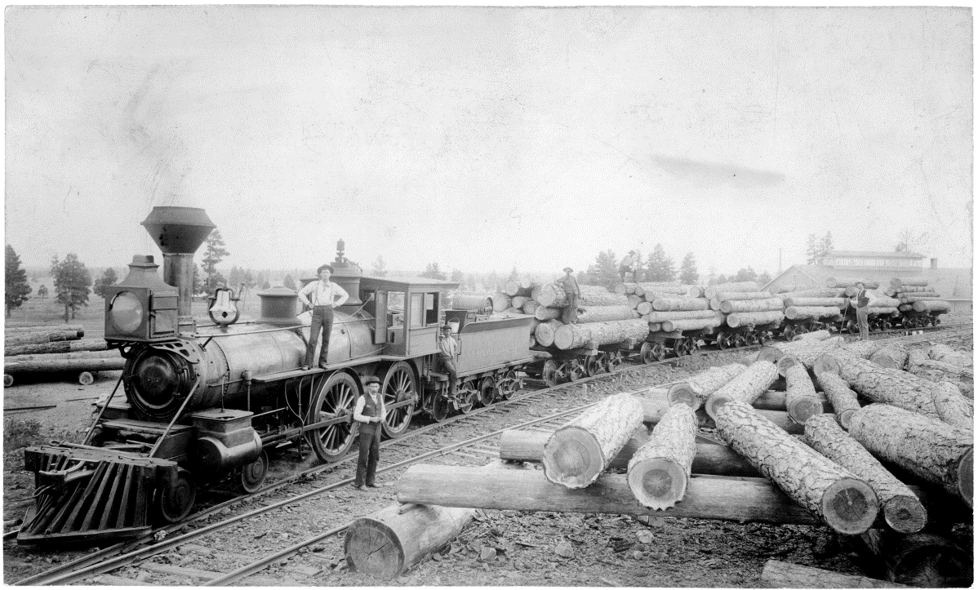
INTERIM REPORT
July 16, 2013
Findings/Advice – Reclaimed water: NDMA from chlorination of wastewater that use chloramines. City’s plants use chlorine and ultraviolet light, however.
Commence testing of reclaimed water for NDMA; however, be cautious that NDMA is notorious for false positives at levels below approximately 5 ng/L. Bring back results to the Panel for next steps.
Antibiotic Resistant Bacteria and Antibiotic Resistant Genes
Antibiotic resistance in human pathogenic microbes
is an on-going public health threat as the number
of available antibiotics is limited and infections are
becoming harder to treat….Antibiotic resistance
is both a man-made & naturally occurring
phenomenon.
2012 study found “genetic markers” of
antibiotic resistance DNA for different
bacteria (dead or alive?)
Ca. 1890. Photo Credit: Northern Arizona University Cline Library [NAU.PH.676.8]

Slide 13
INTERIM REPORT
July 16, 2013
Findings / Advice – Reclaimed Water Antibiotic Resistant Bacteria and
Antibiotic Resistant Genes
Remnant material from bacteria were treated and killed at treatment plant
or the DNA may be from live bacteria originating from pre or post treatment
or growth in distribution system.
Panel expressed caution due to limitations on conclusions of Virginia Tech
study due to:
1. Flagstaff is not exhibiting any public health issues associated with antibiotic
resistance from reclaimed water (pathologist @ hospital)
Can a nexus be drawn between ARB
public health issues and reclaimed water
as the source?
3. Costs of these studies are expensive
Ca. 1890. Photo Credit: Northern Arizona University Cline Library [NAU.PH.676.8]

Slide 14
INTERIM REPORT
July 16, 2013
Interim Recommendations
Sub group of Advisory Panel will help to identify potential individuals or agencies to complete study to better understand public health issues of ARGs and ARBs in water
Compare effects of treatment technologies (chlorination, UV, UV-hydrogen peroxide, membranes) on ARBs and ARGs
No data at present time to suggest that the continued use of reclaimed water provides undue risk to human health. Panel recommends applying the best science available and that above outlined studies be pursued regarding ARB. Future positive results
of ARBs and ARGs will not provide scientific or epidemiologically significant evidence to reverse above
recommendation.

Slide 15
INTERIM REPORT
July 16, 2013
Interim Recommendations
Sub group of Advisory Panel has met to identify opportunities for study and funding relating to ARBs and ARGs:
Virginia Tech - NSF Environmental Engineering Program
TGEN North to include beyond just water (e.g., food)
Collaboration with Univ. of Az & UNLV study WERF
NAU Masters student testing if ARGs present in 9 locations within wastewater treatment process and distribution system
[bar screens - clarification – aeration –UV – Chlorination ]
Advisory Panel’s Sub Group
next meeting October 10th

